Slide 1
Evolution-Natural Selection
Biology

Slide 2
What is Evolution
Change in species over time, it is descent with modification-Watch Video

Slide 3
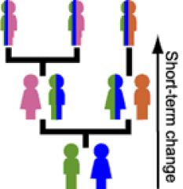
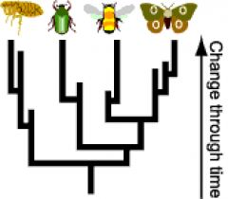
Decent with modifications
This definition encompasses small-scale evolution (changes in gene frequency in a population from one generation to the next)
and large-scale evolution (the descent of different species from a common ancestor over many generations).
Evolution helps us to understand the history of life.

Slide 4
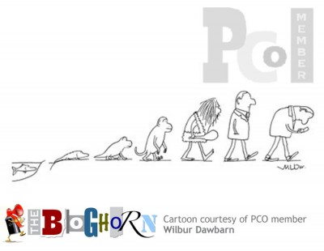
Central Idea
The central idea of biological evolution is that all life on Earth shares a common ancestor, just as you and your cousins share a common grandmother.
Through the process of descent with modification, the common ancestor of life on Earth gave rise to the fantastic diversity that we see documented in the fossil record and around us today.
Evolution means that we're all distant cousins: humans and oak trees, hummingbirds and whales.

Slide 5
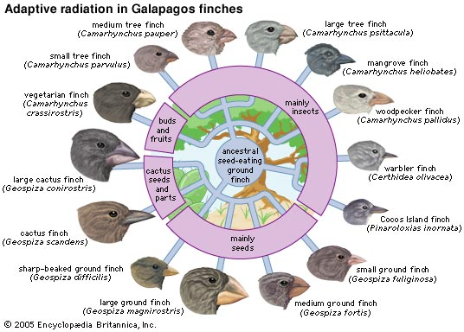
Natural Selection
Natural selection is one of the basic mechanisms of evolution, along with mutation, migration, and genetic drift.

Slide 6
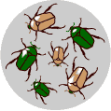
Natural Selection-Variaton of Traits
Darwin’s grand idea of evolution by natural selection is relatively simple but often misunderstood. To find out how it works, imagine a population of beetles:
There is variation in traits. For example, some beetles are green and some are brown.

Slide 7
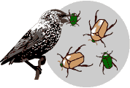
Natural Selection-Differential Reproduction
There is differential reproduction. Since the environment can’t support unlimited population growth, not all individuals get to reproduce to their full potential. In this example, green beetles tend to get eaten by birds and survive to reproduce less often than brown beetles do.

Slide 8
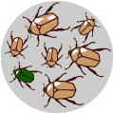
Natural Selection-Heredity
There is heredity. The surviving brown beetles have brown baby beetles because this trait has a genetic basis.

Slide 9
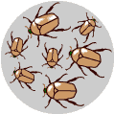
End result: The more advantageous trait, brown coloration, which allows the beetle to have more offspring, becomes more common in the population. If this process continues, eventually, all individuals in the population will be brown.

Slide 10
If you have variation, differential reproduction, and heredity, you will have evolution by natural selection as an outcome. It is as simple as that.

Slide 11
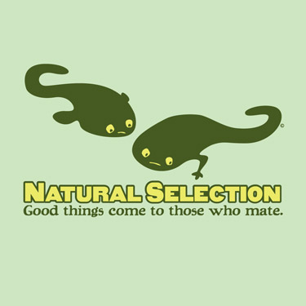
Natural Selection Cont
Follow the link to learn more about Natural Selection and Darwin

