Slide 1
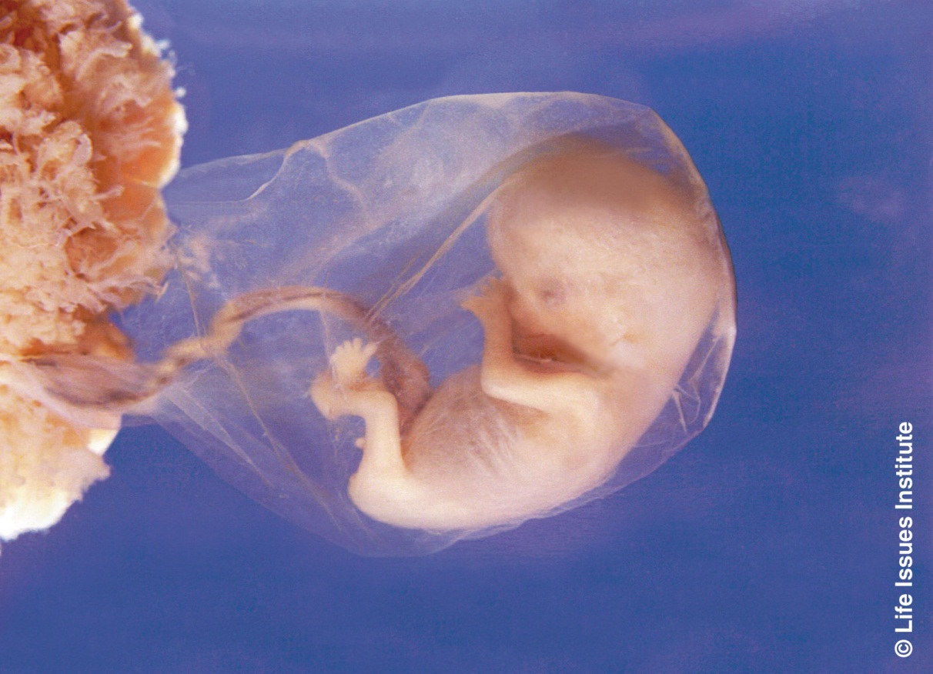
Biology
Bio =
-logy =
life
the study of

Slide 2
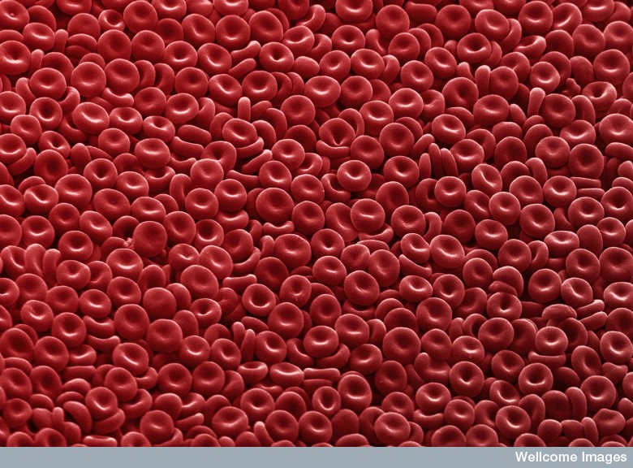
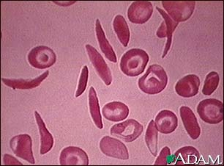
Characteristics of Living Organisms
Made up of Cells.

Slide 3
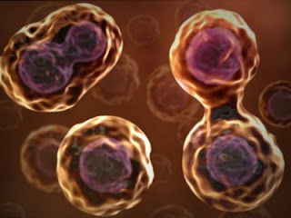
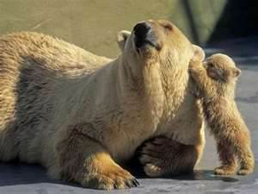
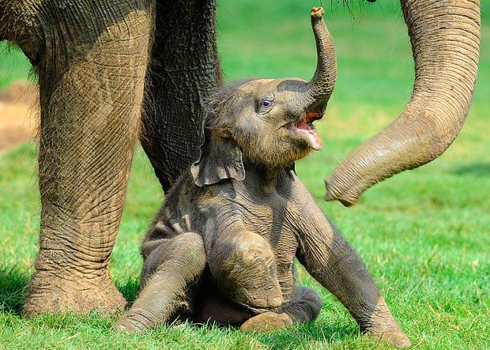
Living Organisms
They reproduce.

Slide 4
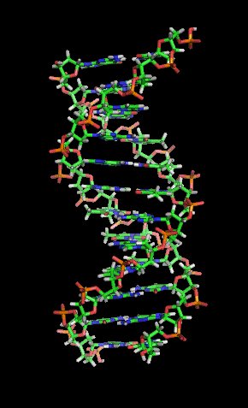
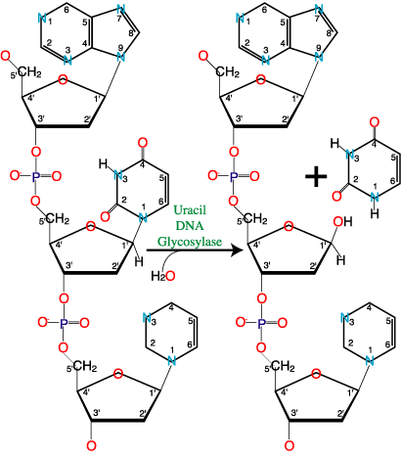
Living Organisms
Carry information that is passed on from generation to generation by DNA and RNA based on a universal Genetic
Code.

Slide 5
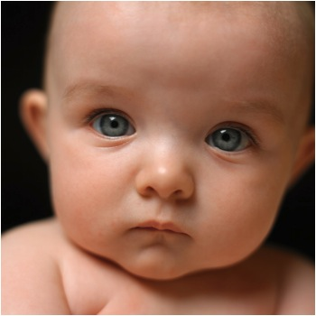

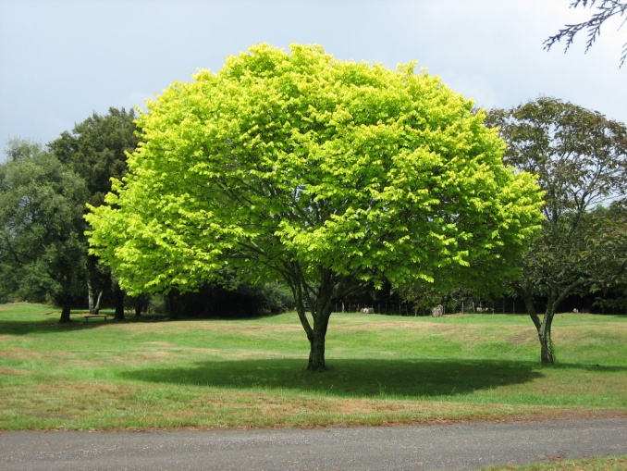
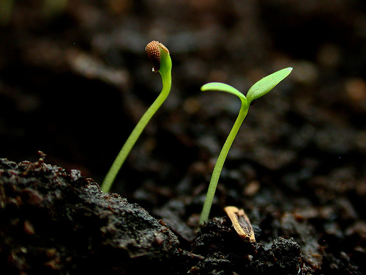
Living Organisms
grow and develop.

Slide 6
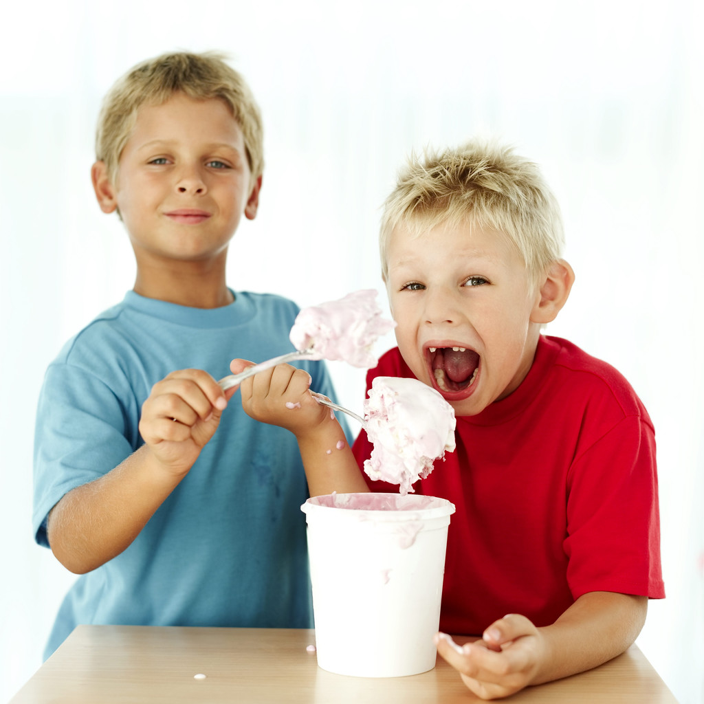
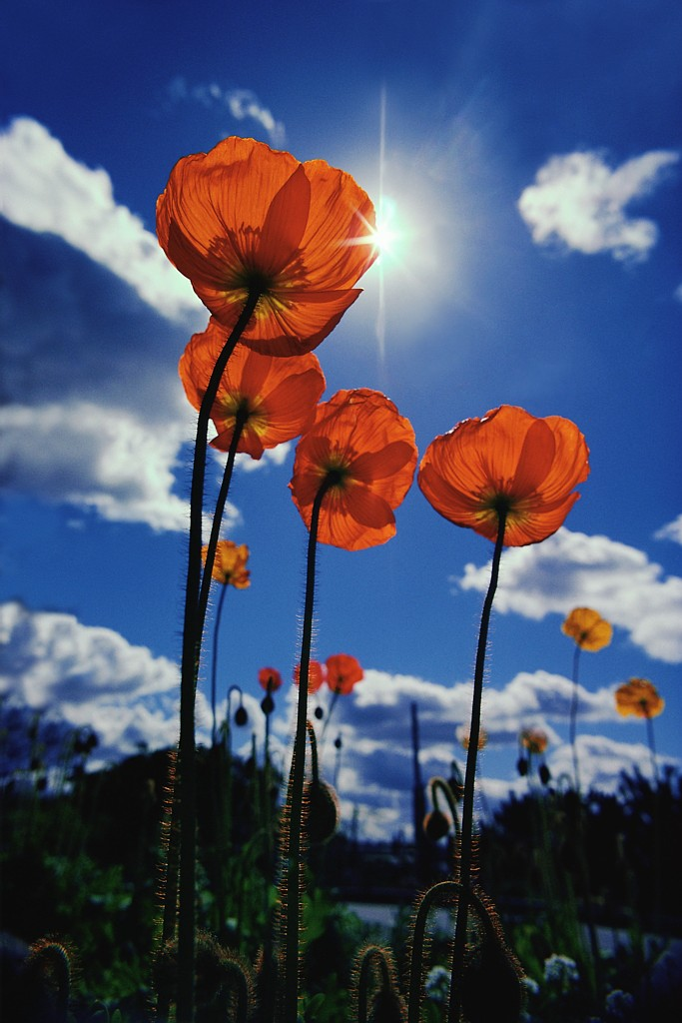
Living Organisms
Obtain and use energy.

Slide 7
Living Organisms
Maintain their internal conditions – homeostasis

Slide 8
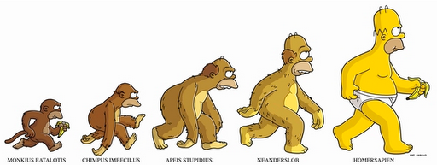
Living Organisms
As a group change (Evolve) over time.

Slide 9
Living Organisms
Respond to the environment.

Slide 10
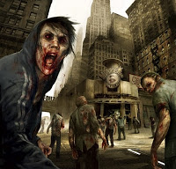
ZOMBIES….
LIVING, NONLIVING or DEAD?
LET’S DISCUSS!
Consider- how do you become a zombie?
Could this really happen?
Now ask yourself, is a zombie living or non-living?
With the knowledge you have learned about zombies answer this question
Next slide has directions for your assignment
Notes:
http://eleusinianmysteriesofreading.blogspot.com/2011/04/surviving-zombie-apocalypse-2.html

Slide 11
Assignment
Write a paper on whether zombies are living or non living.
  Consider all the characteristic of life to answer this question. Make sure you justify your answer with the characteristic.
What would you do in a zombie apocalypse and why?
  Consider environmental factors , food, shelter, reproduction (to save our species), etc.
This should be a well thought out paper with at least 200 words. You should have an opening paragraph and a closing paragraph and at least three or more supporting paragraphs
Use the graphic organizer to help you with your answer. You will be typing this in Schoology under the Pre-AP folder. A link has been added for you to go to Schoology.

